Slide 1
Sending a text SMS via Twilio
with Twilio client
Notes:
[Mandatory Slide] This would be the introduction slide of the topic that you are covering in this subsection.
When this slide plays, you could talk about the main aim that we’d be covering in this video.

Slide 2
In this Video, we are going to take a look at…
Setup your Twilio account
Setup Twilio Python Helper Library
Code sample
Notes:
[Mandatory Slide]
Before the start of the video, we’d like to highlight what are important topics or pointers that we’d be covering in this video. This slide would immediately follow the intro/name slide. This would just be say 2-3 points for the viewers to know what they are getting into.

Slide 3
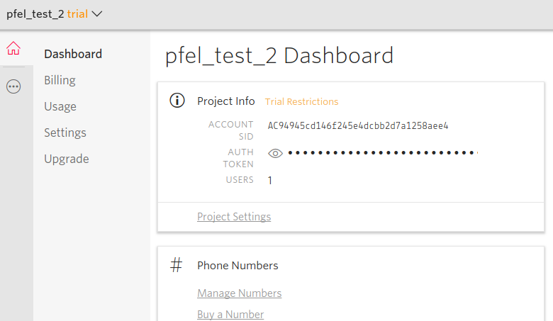
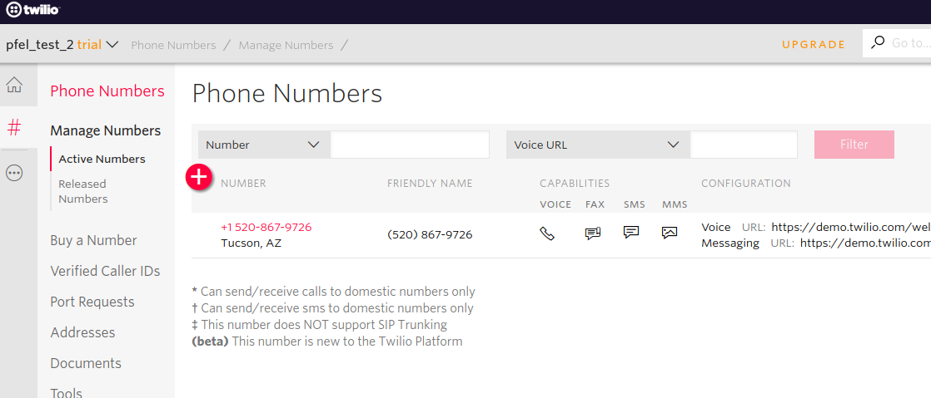


Setup your Twilio account
If you don’t already have one, open up a new Twilio trial account at http://twilio.com: you will be asked to verify a phone number and create a new developer project
Go to the project’s dashboard (https://www.twilio.com/console) and take note of your Account SID and Auth Token
Obtain a free Twilio number capable of sending SMS (eg. a US one). This can be done at https://www.twilio.com/console/phone-numbers. Take note of it
Notes:
[Mandatory Slide]
Before the start of the video, we’d like to highlight what are important topics or pointers that we’d be covering in this video. This slide would immediately follow the intro/name slide. This would just be say 2-3 points for the viewers to know what they are getting into.

Slide 4
Setup Twilio Python Helper Library
Twilio provides an easy to use API SDK. Install it with: pip install twilio
Notes:
[Mandatory Slide]
Before the start of the video, we’d like to highlight what are important topics or pointers that we’d be covering in this video. This slide would immediately follow the intro/name slide. This would just be say 2-3 points for the viewers to know what they are getting into.

Slide 5
Code sample
Notes:
Something that needs to grab the viewers attention!!

Slide 6
Summary
Setup your Twilio account
Setup Twilio Python Helper Library
Code sample
Notes:
[Mandatory Slide]
Before the start of the video, we’d like to highlight what are important topics or pointers that we’d be covering in this video. This slide would immediately follow the intro/name slide. This would just be say 2-3 points for the viewers to know what they are getting into.

Slide 7
Backing up on Dropbox your local data folders with Dropbox client
Next Video
Notes:
[Mandatory Slide]
Here the name of the next video needs to be mentioned. The narration as you guessed it would be just letting the viewer know exactly where we are at and what we’d be taking over next! ☺

